Slide 1
WOMEN SECURITY SYSTEM WITH GPS TRACKING AND MESSAING SYSTEM
D.SAHITHI 15TQ1A0417
K.MAMATHA 15TQ1A0425
N.VINAY KUMAR 16TQ5A0425
N.PRAVEENA 15TQ1A0436

Slide 2
Introduction
In Ancient India women held a high place of respect in the Society.
Woman is a symbol of love, Purity, Sacrifice etc…

Slide 3
Crime Against women
Domestic Violence-Hitting, kicking, biting, shoving, throwing objects.
Criminal Violence- threats, sexual abuse, emotional abuse, kidnapping.
Social Violence- Eve teasing.

Slide 4


Crime Against women contd..
Eve Teasing
Hitting an women

Slide 5
Statistics
92 Women raped in India Every day, 4 in Delhi.
Cases Recorded:
1. Delhi (2013) -1636 cases
2. Mumbai (2013) -391 cases
3. Jaipur(2013) -192 cases
4. Pune (2013) -171 cases

Slide 6
Causes for the crime?
Films and Media- Ads and films with Vulgarity.
Misuse of Internet- India Ranks 2nd in watching porn over the India.
Liquor- Loss of self control .75% of rapes are done by people known.

Slide 7
Existing system for women Security
SHE (Safety, Health and Environment)- Garment that Generates 3800kv up to 80 electric shocks.
ILA Security- 3 Persons alarms to shock an attacker.

Slide 8

Problem Statement
To safeguard the women at the time of harassment.

Slide 9
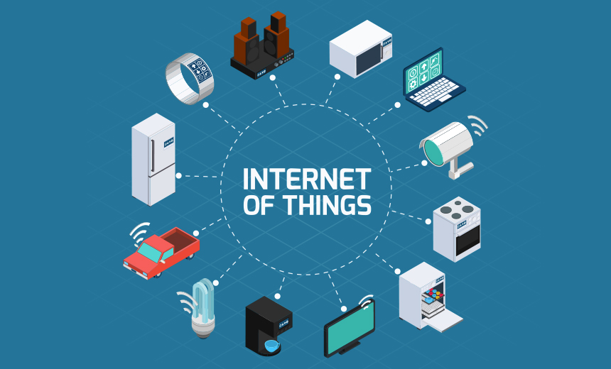
IOT

Slide 10
Advantages over existing system
Comfortable and Easy to use.
Reduced cost.
Reduced Size.
Smart Phone Based.

Slide 11
Approach-Working
where we use Button at the place of anklet and when a women is posed to harassment then the Button Pressed and that will be sent to the controller then, the controller enables the GPS location and tracks the area of women and send the notification to the respected persons whose contacts.

Slide 12
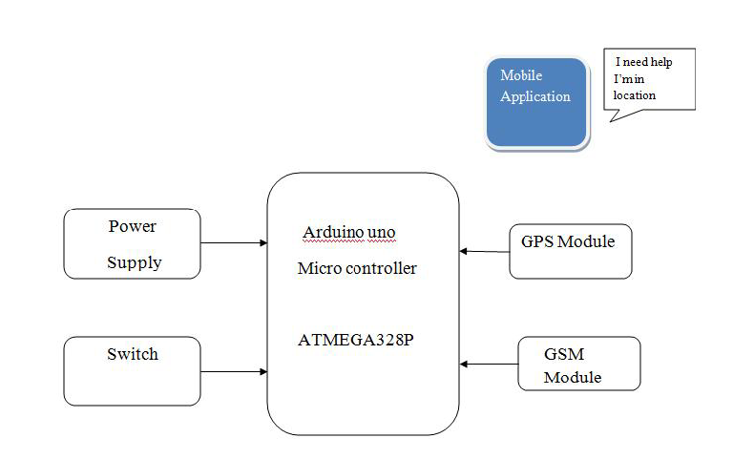
Block Diagram

Slide 13
Hardware Requriments
GPS(Gobal Position System)
GPRS(SIM900)
Arduino uno (Micro Controller)
Button

Slide 14
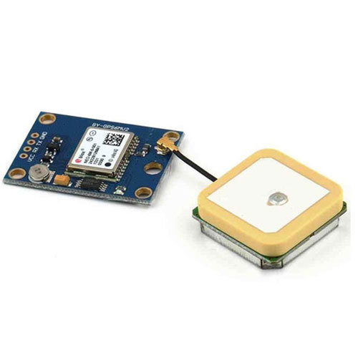
GPS Module
GPS- Determines latitude and longitude of a receiver of Earth by calculating the time difference for signals from various satellites to reach the receiver.

Slide 15
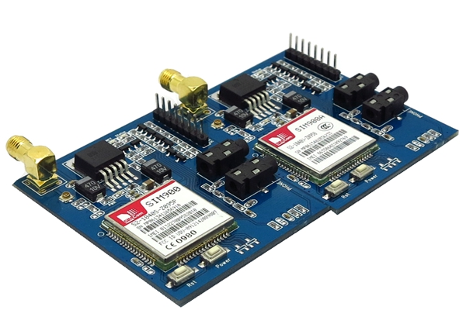
GSM Module
Quad-Band 850/ 900/ 1800/ 1900 MHz
Dual-Band 900/ 1900 MHz
GPRS multi-slot class 10/8GPRS mobile station class B
Compliant to GSM phase 2/2+Class 4 (2 W @850/ 900 MHz)
Class 1 (1 W @ 1800/1900MHz)
Control via AT commands (GSM 07.07 ,07.05 and SIMCOM enhanced AT Commands)
Low power consumption: 1.5mA(sleep mode)
Operation temperature: -40°C to +85 °C

Slide 16
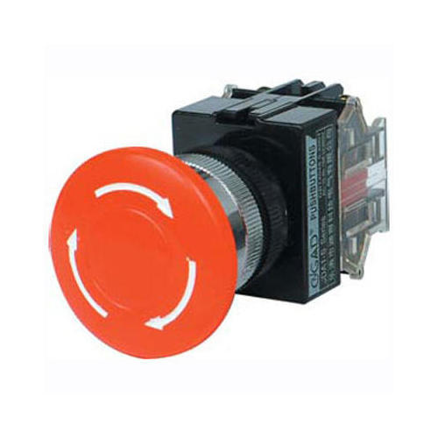
Button
Red pushbuttons can also have large heads (called mushroom heads) for easy operation and to facilitate the stopping of a machine. These pushbuttons are called emergency buttons and are mandated by the electrical code in many jurisdictions for increased safety.

Slide 17
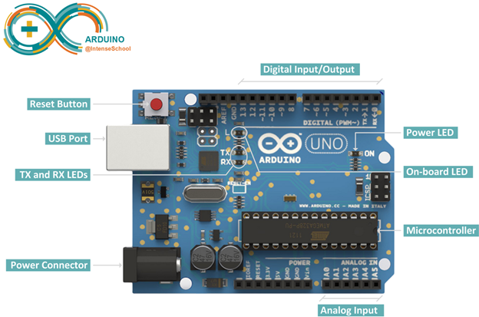
Arduino uno
The Arduino UNO is an open-source microcontroller board based on the Microchip ATmega328P microcontroller and developed by Arduino.cc. The board is equipped with sets of digital and analog input/output (I/O) pins that may be interfaced to various expansion boards (shields) and other circuits. The board has 14 Digital pins, 6 Analog pins, and programmable with the Arduino IDE (Integrated Development Environment) via a type B USB cable.

Slide 18
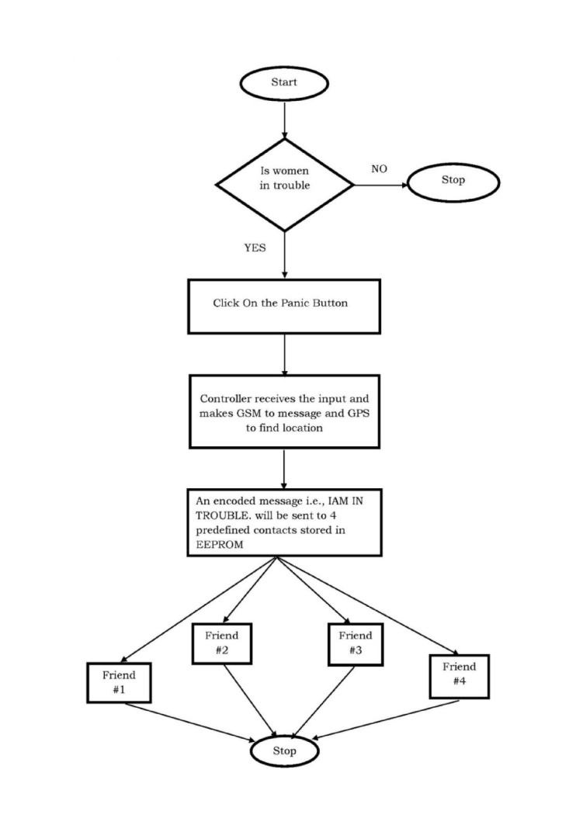
Flow Chart

Slide 19
Applications
Auto motives and transport vehicles
Security, Remote monitoring, Transportation and logistics
This system is also can be interfaced with Vehicle airbag system.

Slide 20
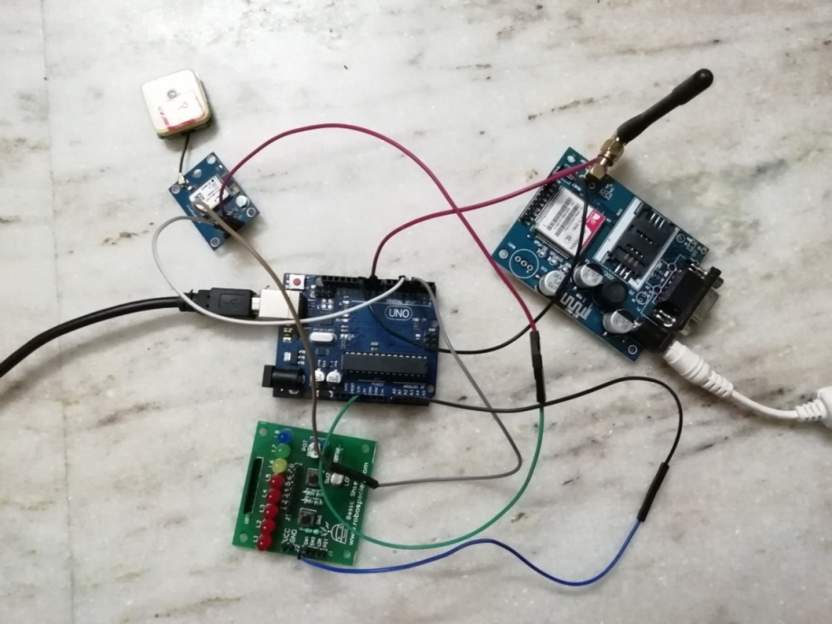
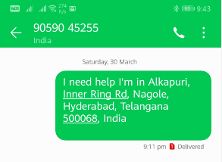
Implementation
System Implementation
System Output

Slide 21
Conclusion
The Advantage of using this project , whenever the button is Pressed we will get the location of the Person from the GPS Module and also send the SMS to the family member through the GSM Module with the location. So, that we can know that the person is in threat and need help at the location.

Slide 22
Future Scope
By encrypting the GOOGLE MAPS in the GPS sensor it can detect the area instead of latitude and longitude information
By using Nano sized materials, the kit size gets reduced
Using wireless GPS modem and wireless Panic button the carrying of the kit can be avoided.

Slide 23
Reference Links
ATMEGA328 Micro controller “A Technical Reference Book ” by J.M Hughes.
“Internet of things” technology Reference by Smart Bridge Educational Services
pvt.ltd
"Power Electronics” by M D Singh and K B Khanchandan
"Linear Integrated Circuits” by D Roy Choudhry & Shail Jain

Slide 24

Query?

Slide 25

Thank you
Save Women, Respect Women, Love Women

